Slide 1
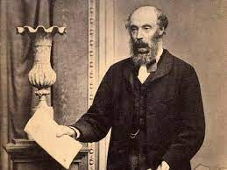
LAW2102 PROPERTY LAW 1
Week 9
Torrens System
Semester 1, 2026
Godzilla? No. It’s Sir Robert Richard Torrens. Presented by Joshua Forrester
(Also known as Torrenzilla)

Slide 2
Today’s Agenda/Learning Objectives
From this lecture you should be able to understand:
The purpose and objectives of the Torrens system.
How the system of deeds registration operates.
The effect of registration on the laws on priorities.
The effect of unregistered instruments.
The concept of deferred and immediate indefeasibility of title and exceptions to indefeasibility under the TLA.
Relevant sections of the Transfer of Land Act 1893 (WA).

Slide 3
Purpose and Objectives of Torrens System
Transfer of Land Act 1893 (WA)
An Act to consolidate the law relating to the simplification of the title to and the dealing with estates in land.
One of the cardinal objectives of the Torrens system is to facilitate the proof of title to estates in land. It was of the very essence of the scheme designated by Torrens that henceforth, the mere presence of the document of title in the register book should prove such title to all the world and against the world. Therefore, every bona fide purchaser without notice can rely absolutely on the title appearing in the register book, and on becoming registered in respect of such title, cannot be defeated in his purchase, notwithstanding whatsoever flaws there may have been in the title of his vendor.
Kerr, The Principles of the Australian Land Titles (Torrens) System, 1927, 165

Slide 4

Purpose and Objectives of Torrens System
The Torrens system priority is based on the date of registration, not the date of execution: s 53(2) TLA.
Registration creates a legal interest in property or, as Barwick CJ once famously said, the Torrens system ‘is not a system of registration of title but a system of title by registration’: Breskvar v Wall (1971) 126 CLR 376, 386.
This legal interest takes priority over all later registered (legal) and all (earlier and later) unregistered (equitable) interests…
UNLESS there are exceptions (discussed later).

Slide 5
Torrens registration process
Part III Certificates of Title & Registration ss 48-52 TLA
Registrar maintains a register book which comprises certificates of title representing parcels of land (s 48)
New certificate of title created in approved form (s 48A)
Registrar must not issue duplicate certificate of title (s 48B) (since 2022)
CT registered in book when given a reference number and has been sealed (s 52)
CT instruments registered in the order in which they are lodged (s 53)

Slide 6
Effect of Registration
The act of registration of an interest not only records the title but registration itself creates legal title.
Upon registration the instrument forms part of the register and has effect as a deed: s 85 TLA. It acquires protection under the principle of indefeasibility
Registration generally creates a legal interest: s 58.
Unregistered instruments can still give rise to an equitable interest: Barry v Heider (1914) 19 CLR 197, 216.
Note: registration of a caveat does not create an interest – it is only a notice or ‘warning’ of it.
The two most important concepts of Torrens are:
Title created by registration: s 58 TLA; and
Indefeasibility of title: s 68.

Slide 7
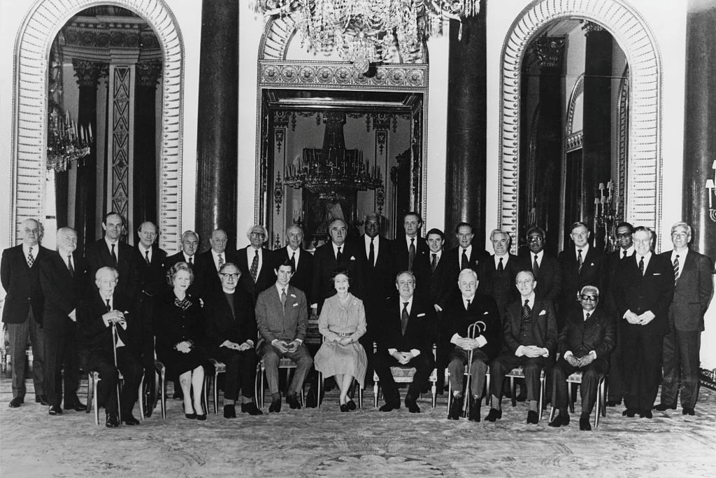
Torrens Indefeasibility of Title
Indefeasibility of title describes the protection afforded to a registered interest by registration.
[A] convenient description of the immunity from attack by adverse claims to land or interest in respect of which he is registered, which a registered proprietor enjoys. This concept is central in the system of registration. It does not involve that the registered proprietor is protected against any claim whatsoever: as will be seen later, there are provisions by which the entry on which he relies may be cancelled or corrected, or he may be exposed to claims in personam. These are matters not to be overlooked when a total description of his rights is required. But as registered proprietor, and while he remains as such, no adverse claim (except as specifically admitted) may be brought against him.
Frazer v Walker [1967] 1 AC 569 (Privy Council).
Privy Council circa 1967 (give or take a couple of years).

Slide 8

Torrens Indefeasibility of Title
The construction of indefeasibility of title out of sometimes incomplete and overlapping TLA provisions: see ss 63, 53, 68, 134, 199, 202.
The four elements of indefeasibility are:
A registered title is conclusive regardless of defects;
Registration gives priority against all, except exceptions that are recognised;
A registered proprietor is not affected by actual or constructive notice of an unregistered interest and has no obligation to inquire into quality of title;
Only exceptions in the TLA affect a registered interest.
I am Four!

Slide 9

Torrens Indefeasibility of Title
Immediate indefeasibility – gives good title immediately upon registration, so that upon registration of even a forged transfer the registered transferee is entitled to protection, provided this person was not fraudulent (in the broad sense of not having engaged in any wrong doing) and was a bona fide purchaser for value.
Frazer v Walker [1967] 1 AC 569
Mr and Mrs Frazer owned a farm. Mrs Frazer forged Mr Frazer’s signature to obtain loan from Mr and Mrs Radomski (who didn’t know about the fraud). This loan was secured by amortgage in favour of the Radomskis over the farm. Mrs Frazer failed to repay loan so the Radomskis sold the property to Walker. When Walker tried to take possession, Mr Frazer refused and Walker took action for possession.
Held: Walker got good title because although title obtained by the Radomskis due to Mrs Frazer’s fraud, Walker was innocent purchaser for value (without notice).
Disclaimer: The individuals pictured may not be the real Mr and Mrs Frazer.

Slide 10
Torrens Indefeasibility of Title
Breskvar v Wall (1971) 126 CLR 376
Not just known for Barwick CJ’s pithy catchphrase (see previous slide) but for affirming the PC decision in Frazer v Walker
And, has its own Wikipedia entry (how cool is that!) as follows:
Essentially this was a contest between two innocent parties, the Breskvars and Alban Pty Ltd in relation to the ownership of a two acre block of land at Acacia Ridge, Brisbane, each of who were victims of fraud by Petrie and Wall. Whoever succeeded would be the owner of the land, while the other party would be left to recovering damages against Petrie and Wall. Emilie & Franc Breskvar were the registered owners of the land. They took a loan of $1,200 from Petrie and gave Petrie the title documents and transfer papers as collateral. Petrie fraudulently inserted the name of his grandson G.W. Wall onto transfer papers and had it registered with Titles Office. Petrie, on behalf of Wall sold the property for $3,500 to Alban Pty Ltd who were unaware of the fraud. The Breskvars were trying to sell the land and discovered that Wall had been registered on the title and lodged a caveat in an attempt to prevent the property from being sold. The caveat was lodged after the sale to Alban Pty Ltd had been completed, but before the transfer had been registered.
Note: The grandson, Wall, was ‘in on it’ so he didn’t get indefeasible title. (fraud = exception to indefeasibility). But Albans as innocent purchasers for value (without notice) did get indefeasible title.

Slide 11

Torrens Indefeasibility of Title
The Barwick dictum – let’s hear it again in all its glory!
The Torrens system of registered title … is not a system of registration of title but a system of title by registration. That which the certificate of title describes is not the title which the registered proprietor formerly had, or which but for registration would have had. The title it certifies is not historical or derivative. It is the title which registration itself has vested in the proprietor. Consequently, a registration which results from a void instrument is effective according to the terms of the registration. It matters not what the cause or reason for which the instrument is void.
Breskvar v Wall (1971) 126 CLR 376, 386 (Barwick CJ)
Or, as put by the Backstreet Boys equally eloquently:
‘Don’t care who you are are, where you’re from, what you did, as long as you love me are registered’.
(But does registration make you larger than life? Hmmm…

Slide 12
Torrens Indefeasibility of Title
Limits to indefeasibility
Indefeasibility under the Torrens system does not extend to personal rights unrelated to the land, even if the personal right is included in the registered instrument (in personam rights)
Indefeasibility extends only to those covenants so closely connected as to be regarded as part of the interest obtained by the registered instrument: Mercantile Credits Ltd v Shell (1976) 136 CLR 329.
Indefeasibility extends to option to renew in registered lease (but not to matters unconnected with lease such as option to purchase reversionary interest or a clause limiting the landlord from leasing out its adjacent parcels of land to competitors).

Slide 13
Torrens Indefeasibility of Title – exceptions within TLA – s68(1A). Here it is again!
s 68(1A) Despite subsection (1), the land which shall be included in any certificate of title or registered instrument shall be deemed to be subject to the reservations exceptions conditions and powers (if any) contained in the grant thereof or transfer of the fee simple or otherwise and to any rights subsisting under any adverse possession of such land and to any public rights of way and to any easements acquired by enjoyment or user or subsisting over or upon or affecting such land and to any unpaid rates and to any mining lease or licence issued under the provisions of any statute and to any prior unregistered lease or agreement for lease or for letting for a term not exceeding 5 years to a tenant in actual possession notwithstanding the same respectively may not be specially notified as encumbrances on such certificate or instrument but no option of purchase or renewal in any such lease or agreement shall be valid as against a subsequent registered interest unless such lease or agreement is registered or protected by caveat.

Slide 14

But there are exceptions to indefeasibility of title in section 68(1) itself? The ‘Oops’ exceptions)
s 68(1)TLA:
Notwithstanding the existence in any other person of any estate or interest whether derived by grant or transfer of the fee simple from the Crown or otherwise which but for this Act might be held to be paramount or to have priority the proprietor of land or of any estate or interest in land under the operation of this Act shall except in case of fraud hold the same subject to such encumbrances as may be notified on the registered certificate of title for the land; but absolutely free from all other encumbrances whatsoever except the estate or interest of a proprietor claiming the same land under a prior registered certificate of title and except as regards any portion of land that may by wrong description of parcels or boundaries be included in the certificate of title or instrument evidencing the title of such proprietor not being a purchaser for valuable consideration or deriving from or through such a purchaser.
In other words, someone at Landgate has stuffed up!

Slide 15
Torrens Indefeasibility of Title – Correcting Errors
s 76(1) The Registrar’s power of correction
In case it shall appear to the satisfaction of the Commissioner that any duplicate certificate of title or instrument has been issued in error or contains any misdescription of land or of boundaries or that any entry or endorsement has been made in error on any duplicate certificate of title or instrument or that any duplicate certificate instrument entry or endorsement has been fraudulently or wrongfully obtained or that any duplicate certificate or instrument is fraudulently or wrongfully retained he may by notice in writing require the person to whom such document has been so issued or by whom it has been so obtained or is retained to deliver up the same for the purpose of being cancelled or corrected …
Commentary on s 76 –
The Registrar can cancel or correct a document where fraud has occurred. However, s 76 has not been interpreted to create a further exception to indefeasibility. The power is used only in simple cases where there is no difficult question of law or fact to be resolved, and the power will not be used where a bona fide purchaser has acquired an interest.
Frazer v Walker case

Slide 16
Torrens Indefeasibility of Title – Correcting Errors
Section 188(3) TLA: Registrar’s power of correction
The Registrar shall upon the direction of the Commissioner correct errors in the Register or in entries made therein or in duplicate certificates (in cases of paper titles) or instruments or graphics and may supply entries omitted to be made under the provisions of this Act.
Commentary on s 188 – Errors can be corrected but without prejudice to rights arising from a prior entry on the register. So the Registrar’s power is limited to the period before a bona fide purchaser or mortgage acquires an interest, having relied upon the register.

